Slide 1



EduLinux: A Custom Linux Distribution for Educational Purposes
This paper presents the design and implementation of EduLinux, a custom Linux distribution tailored for educational purposes.

Slide 2


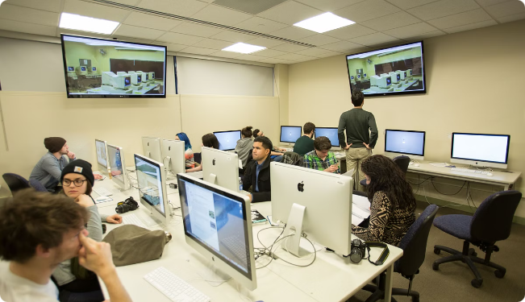
Introduction
1
Linux Distributions
Increasingly popular due to flexibility, open-source nature, and robust security features.
2
Customization
Tailored to meet specific needs, particularly appealing for educational settings.
3
Traditional Educational Environments
Challenges include limited resources, outdated hardware, and a lack of tailored software tools.
4
EduLinux
Addresses these challenges and provides a comprehensive, optimized platform for learning and teaching.

Slide 3
Background
Linux
Educational Institutions
EduLinux
Open-source operating system kernel, foundation for numerous distributions.
Can benefit from customized distributions that include pre-installed educational software, development tools, and collaborative platforms.
Designed to create a user-friendly, secure, and efficient operating system for the educational sector.

Slide 4


Literature Review
Open Source in Education
Advocates for the use of free software in education, highlighting the ethical and practical benefits of open-source solutions.
Custom Linux Distributions
Previous research provides a foundation for understanding the technical aspects and potential benefits of creating tailored distributions.
Educational Tools and Software
The integration of educational tools and software in Linux distributions has been explored by various researchers.

Slide 5

Existing Methods
Debian Live
Framework for creating custom live images of Debian-based distributions.
Ubuntu Customization Kit
Tool specifically designed for customizing Ubuntu distributions.
Remastersys
Tool used to create custom live and installable versions of Debian and Ubuntu-based distributions.

Slide 6





Problem Statement
Limited Resources
Educational institutions face challenges in implementing technology due to limited resources.
Outdated Hardware
Outdated hardware can hinder the use of modern software and tools.
Lack of Tailored Software Tools
There is a need for a custom Linux distribution that addresses these challenges.

Slide 7
Proposed Method
Requirements Analysis
1
Identify the needs of students, educators, and institutions.
2
Base Distribution Selection
Select an appropriate base distribution, such as Ubuntu.
Customization
3
Customize the base distribution to include educational software, development tools, and security features.
4
Building the Distribution
Use tools like Debian Live or Ubuntu Customization Kit to create a custom live image of EduLinux.
Testing and Quality Assurance
5
Conduct thorough testing to ensure the distribution is reliable, secure, and performs well.
6
Documentation and Support
Provide comprehensive documentation and support resources.

